Slide 1

Invest-a-Bull
Discovering investment opportunities.
Your choice of 5 assets i.e (Stocks or Crypto)
Amount of capital you want to invest.
Select a duration for your investments

Slide 2
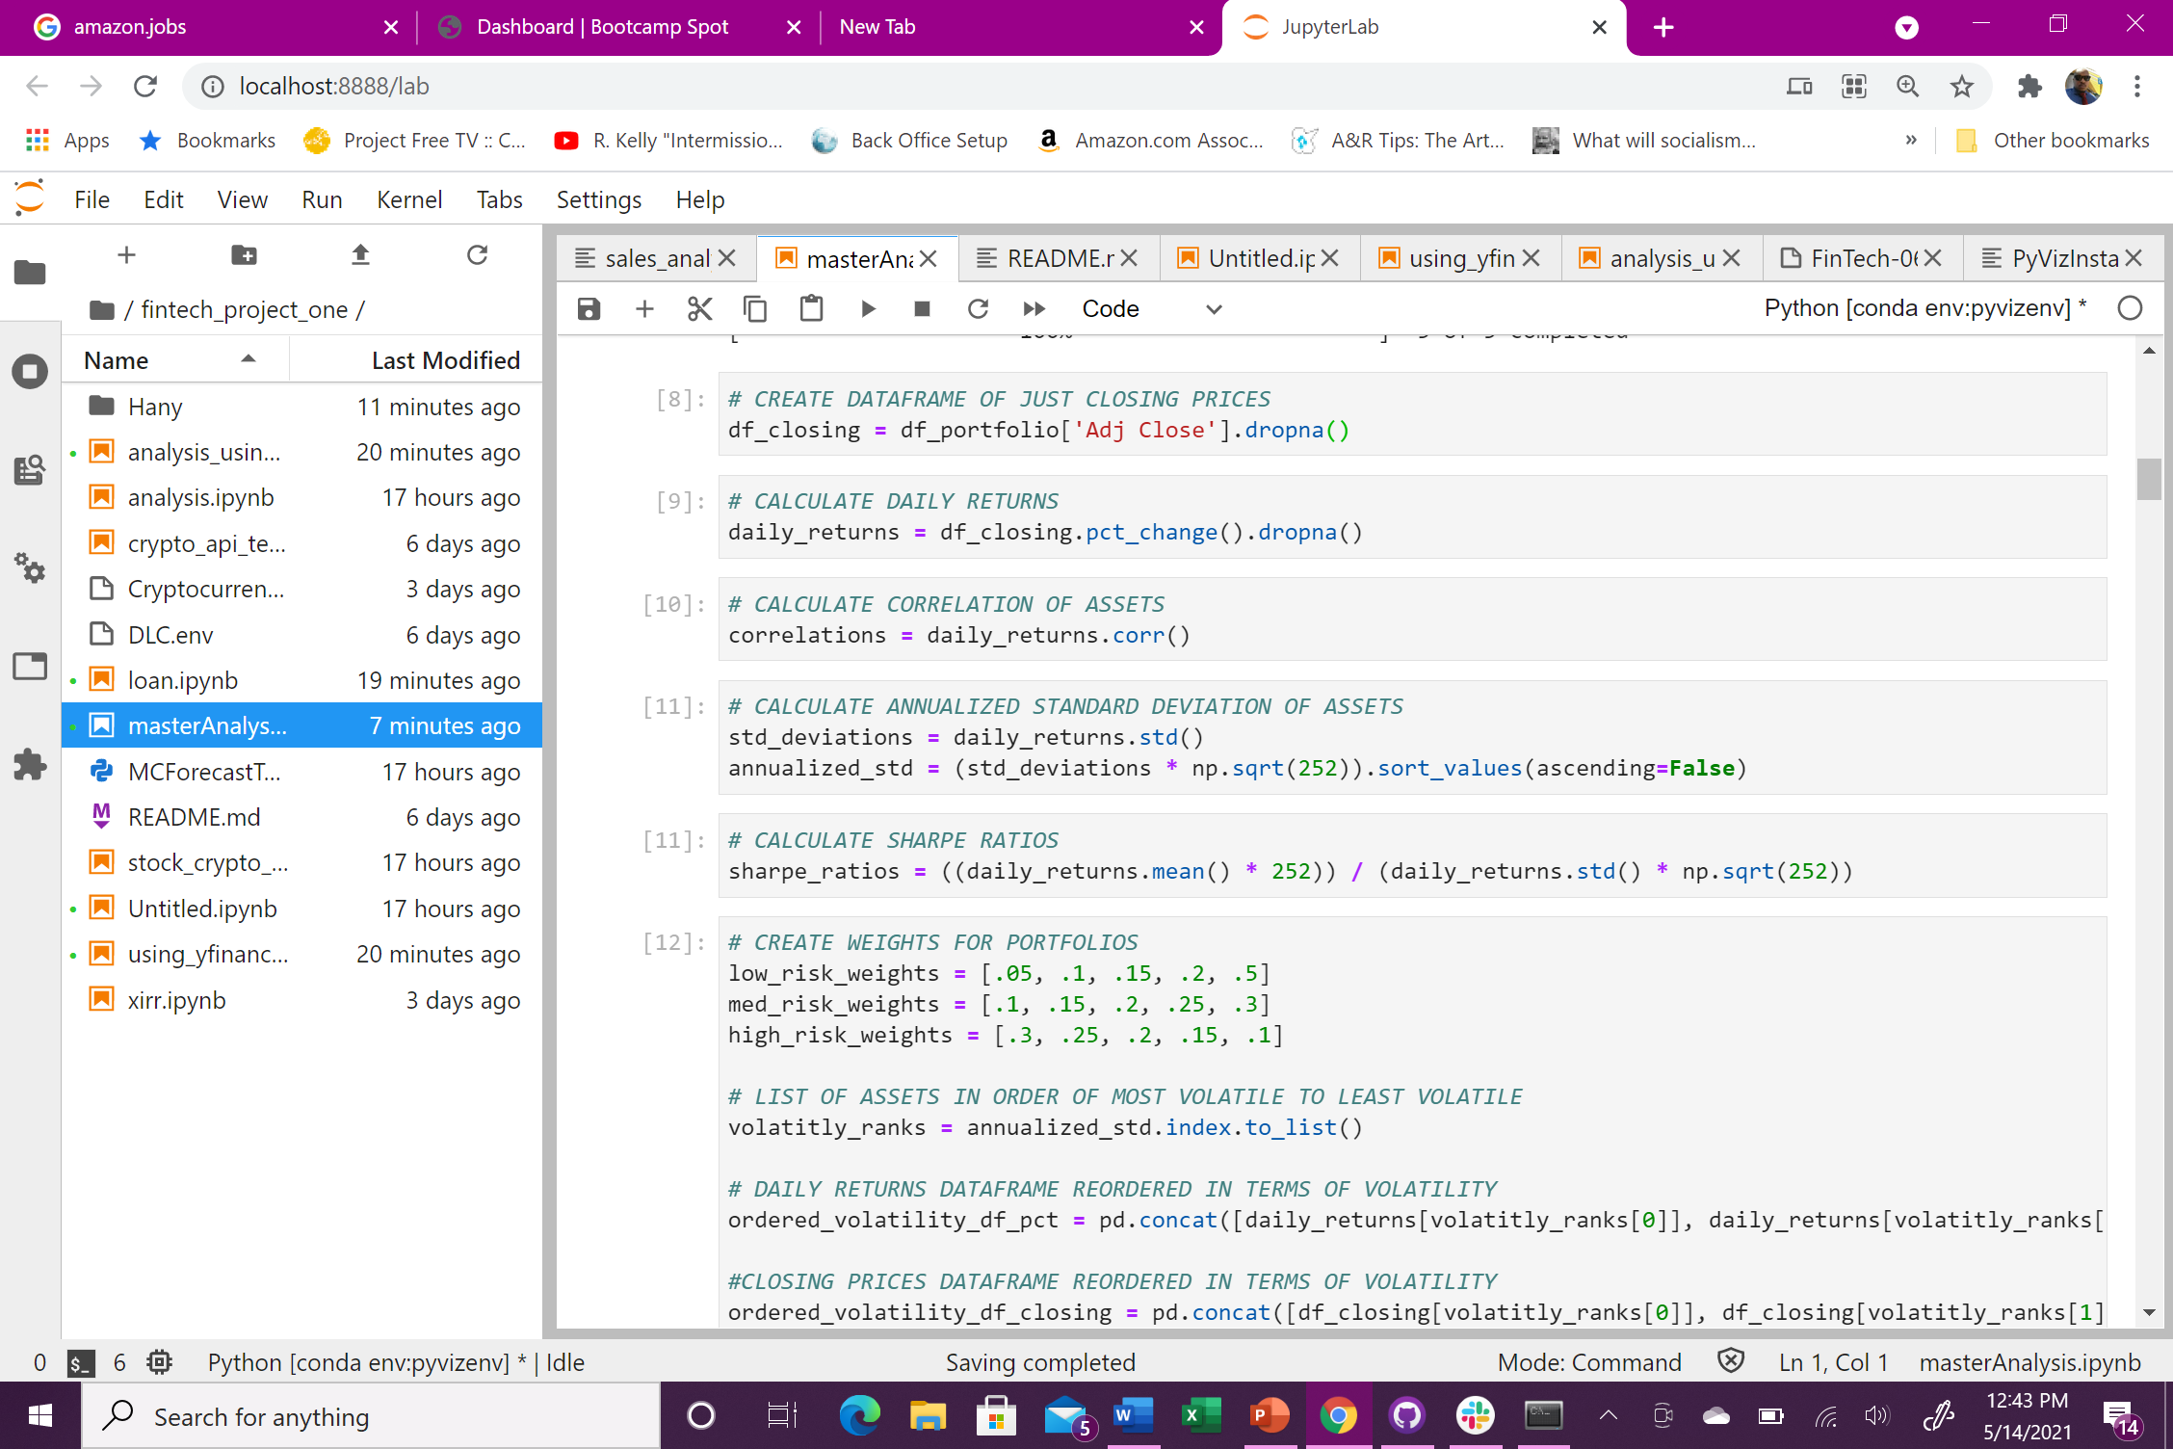
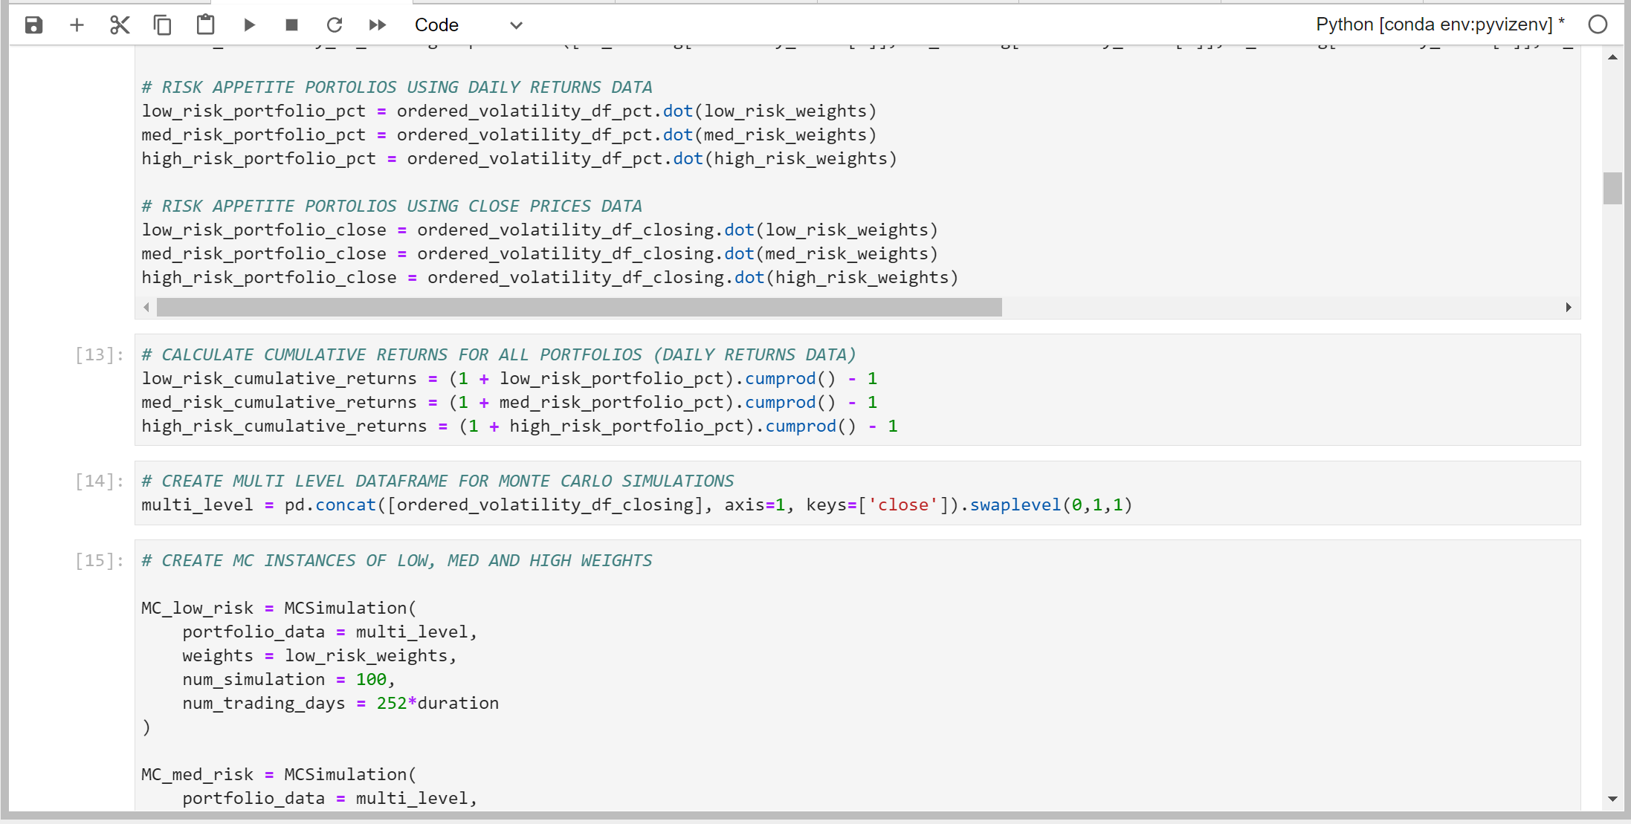
Analysis Breakdown
Calculation of percent change, correlation, annualized standard deviation and Sharpe ratios
Assets ranked in terms of volatility
3 sample portfolios are provided based on weighted risk appetite
Cumulative returns are calculated based on daily returns data
MC simulations are then used to help predict the probability of each weighted risk.
Finally the data is entered into a dashboard for visualization

Slide 3
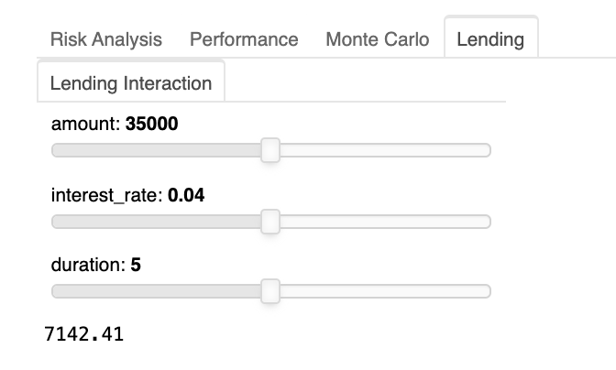
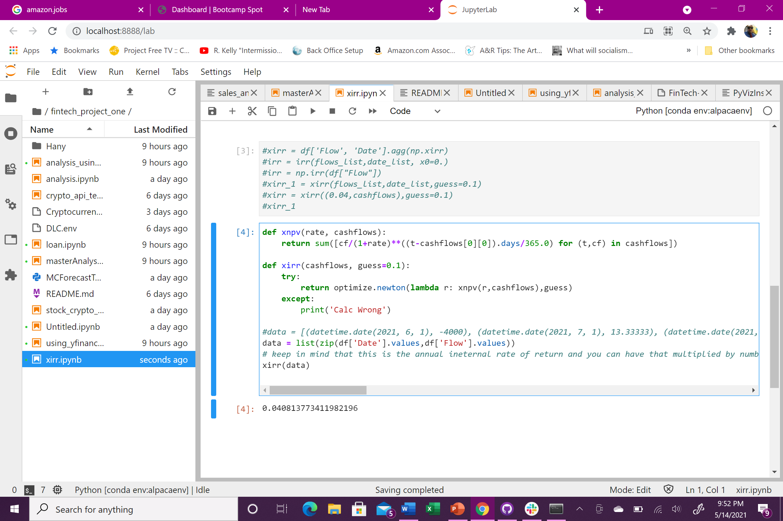
Lending Investment products have been around, but they have not been utilized as true investment product until recently. High rated loans could have higher return than investment grade bonds with 0.01% probability of default. Mimicking the traditional hedging concept, we incorporated the lending aspect in crypto as part of investment to create a balance against the price volatility of stocks and crypto currencies. Lending rate will be based on the loan to value of the borrower’s account. Investors/Lenders will guarantee a full year of return because the borrower will have a none call penalty for a year. The component of the loan return will be calculated based on the internal rate of return, the XIRR function that we created in our tool.

Slide 4

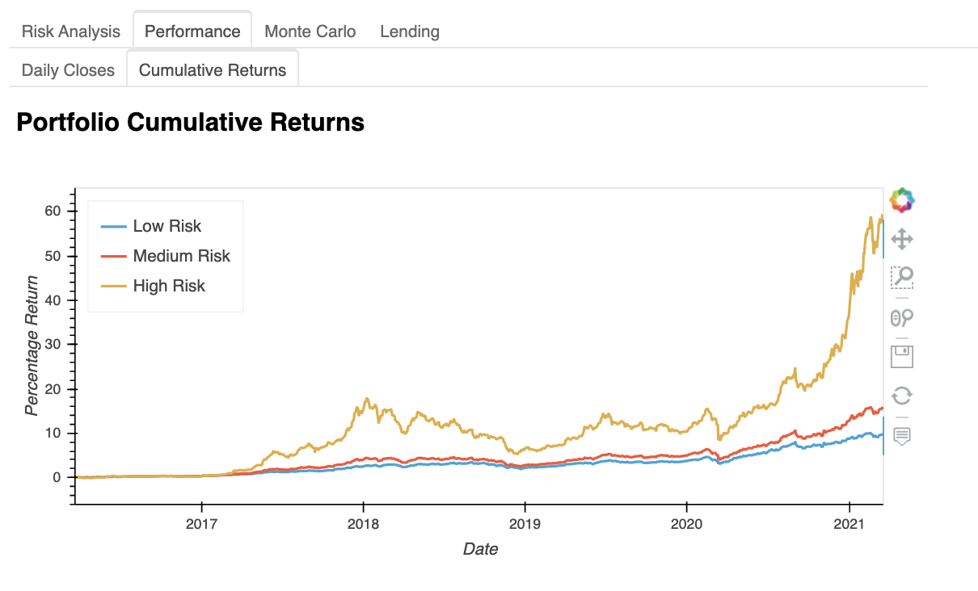
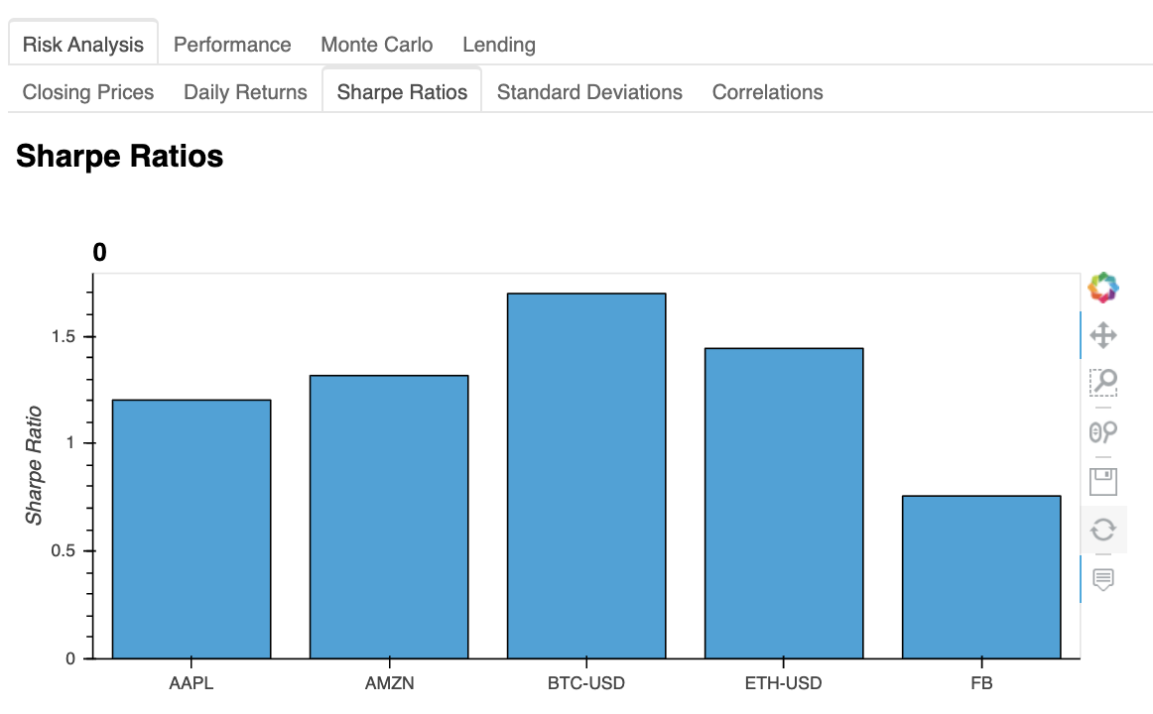
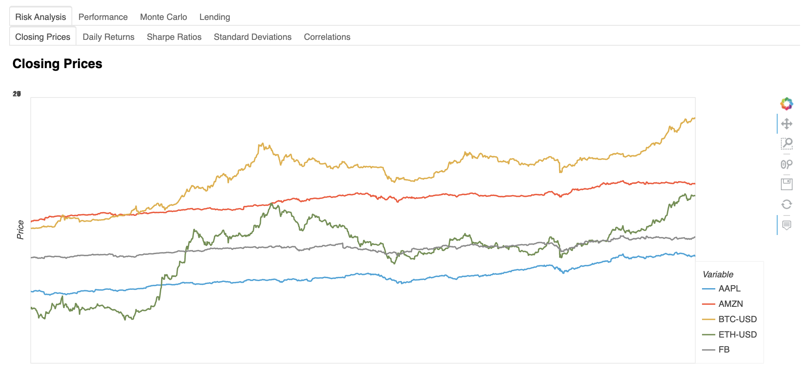
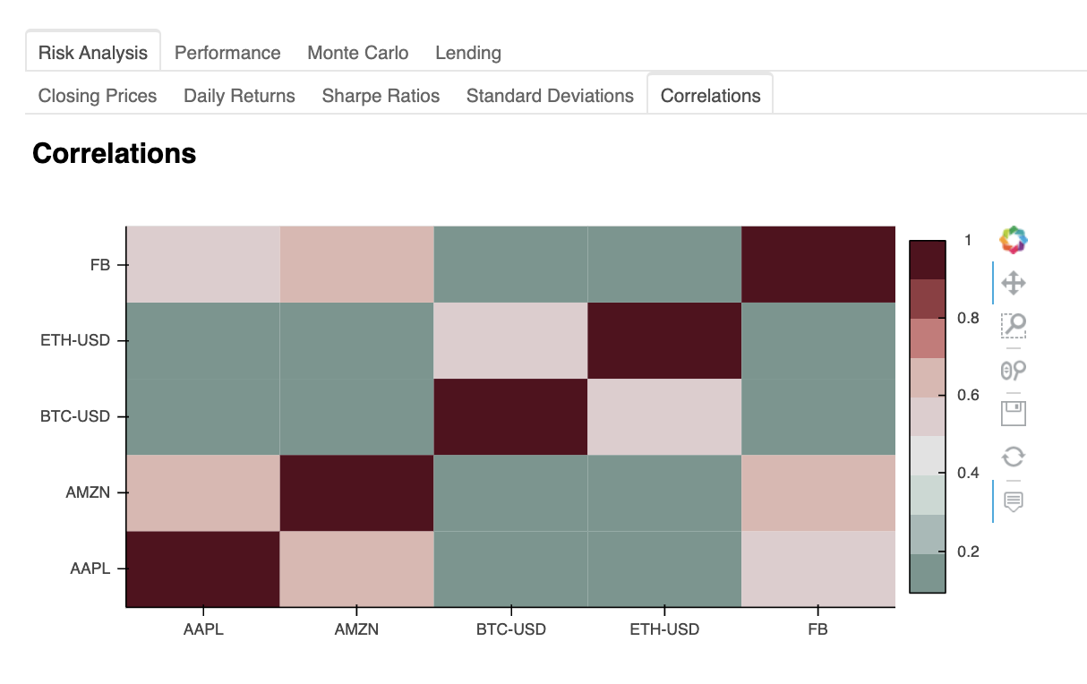
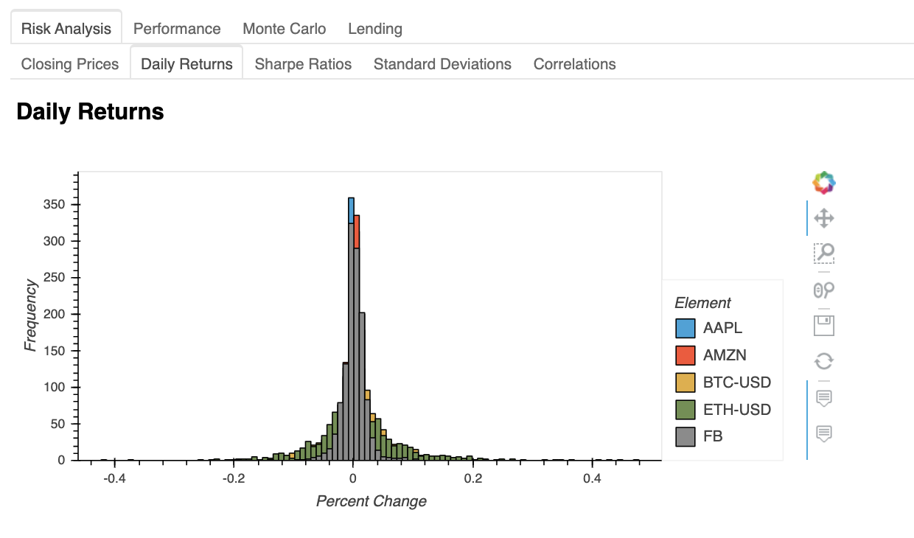
VISUALIZATIONS

Slide 5
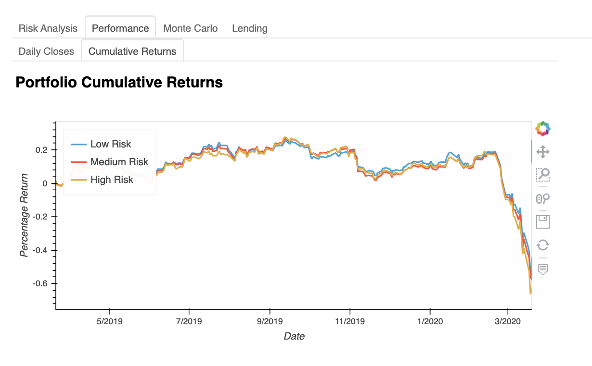
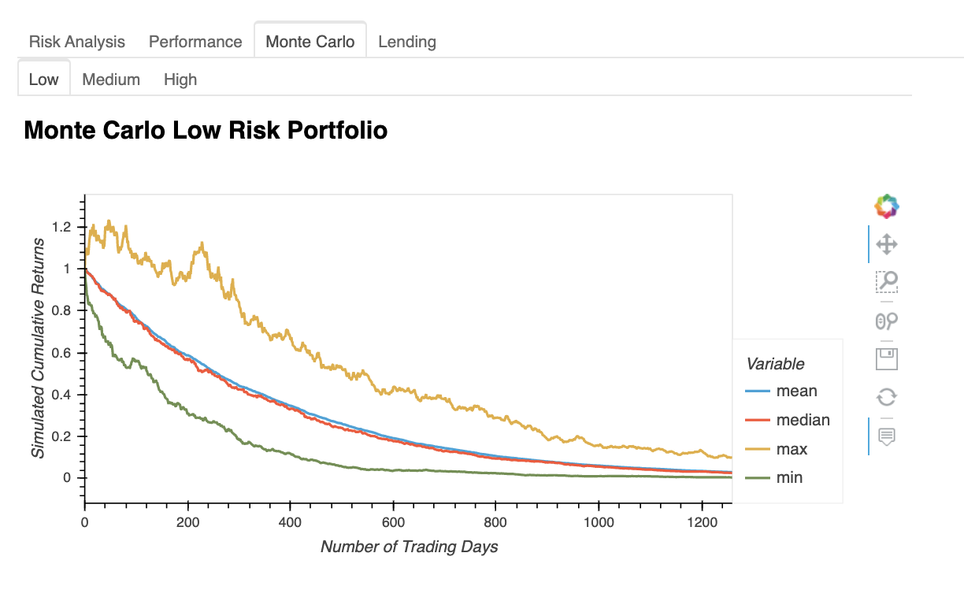
Conclusion
These 3 graphs show you what can happen when we have losing assets
Our lending aspect helps to hedge against the assets in your portfolio, which would offset your loses in the event of another crisis

Slide 6
QUESTIONS?

